Slide 1


Stylometry based Authorship Identification
Vivekanand Education Society’s Institute Of Technology
Department Of Computer Engineering
Group Members(Class,Roll no.)
Shashank Agnihotri(D17C,2)
Anshul Agarwal(D17B,2)
Mahak Pancholi(D17B,51)
Pooja Hande(D17C,23)
Mentor Details:
Name: Mrs.Sujata Khedkar
Designation: Associate Professor
Notes:
NOTE:
To change the image on this slide, select the picture and delete it. Then click the Pictures icon in the placeholder to insert your own image.

Slide 2
INDEX
Vivekanand Education Society’s Institute Of Technology
Department Of Computer Engineering

Slide 3
Index
Introduction……………………………………4
Problem Definition…………………………….6
Literature Survey……………………………....8
Block Diagram………………………………..13
Algorithms Implemented……………………..15
Specifications…………………………………18
Constraints……………………………………21
UI Screenshots………………………………..23
Results Obtained……………………………...28
Graphs Generated…………………………….31
Comparison With The Existing System……...34
Comparative Analysis………………………..38
Limitations…………………………………...42
Future Scope…………………………………44
Conclusion …………………………………..46
References…………………………………...48

Slide 4
INTRODUCTION
Vivekanand Education Society’s Institute Of Technology
Department Of Computer Engineering

Slide 5
Introduction
Stylometry – the measure of style – integrates literary stylistics, statistics and computer science in the study of the “style” or the “feel” of a document.
The style of a document is typically based on a lot of parameters – its genre or the topic (which is used in text categorization), its content, its authors - to name a few.
Stylometry assumes – in the context of author attribution - that there is an unconscious aspect to an author's style that cannot be consciously manipulated but which possesses quantifiable and distinctive features.
In this project we attempt to recognize different authors based on their style of writing.
This project has an important applications, plagiarism detection.

Slide 6
PROBLEM DEFINITION
Vivekanand Education Society’s Institute Of Technology
Department Of Computer Engineering

Slide 7
Problem Definition
Stylometry based authorship attribution
In this project,
-we attempt to solve author attribution problem.
-we will also compare different feature extraction methods and classifiers and see which one gives the best accuracy for the above problem.

Slide 8
LITERATURE SURVEY
Vivekanand Education Society’s Institute Of Technology
Department Of Computer Engineering

Slide 9
Literature Survey
Paper | Method | Pros | Cons
Stylometry-based Fraud and Plagiarism Detection for Learning at Scale Year and Journal: Conference paper- researchgate, 2015 | POS using the Penn-Treebank tagger Bootstrap samples Svm with 2 classes | Prediction quality of binary SVMs trained with this method is higher The specificity of words used by an author is a discriminating feature | Cannot be extended to texts written in languages other than English.
Author Verification Using a Semantic Space Model Year and Journal: Computación y Systems 2017 | LDA Naïve Bayes for classification. | Semantic analysis of corpus | To classify a new unknown document it would be necessary to reprocess all documents including new ones.

Slide 10
Literature Survey
Paper | Method | Pros | Cons
Learning of Authorship De-Identification Using Stylometric Functions Year and journal : IEEE IRI 2014 | Multilayer Perceptron Random forest Support vector machines k-nearest neighbors | MLP learner, combined with the six categories of stylometric features, provides better performance over other classifiers and baseline approaches. | Random forest and k-nearest neighbors give low accuracy. Only few authors can be identified accurately.
An Experimental study of Stylometry in Bangla Literature Year and journal: EICT 2015 | Jaccard Similarity Standard Deviation Cosine similarity | Analysis of twelve features according to the style of Bangla literature was possible. Standard deviation and Jaccard Similarity are comparatively easy to calculate. Can be extended to texts written in languages other than English. | These two methods do not identify all the authors from the data set.

Slide 11
Literature Survey
Paper | Method | Pros | Cons
Using Machine Learning Techniques for Stylometry. | Kohonen Self Organizing Maps Backpropagation | Suitable to capture an intangible concept like style. Fewer input variables are required as compared to the traditional statistics. | Implemented for small number of authors only.
Authorship Verification for Short Messages using Stylometry Year and Journal: CITS 2013 | N-gram algorithm Computing False Acceptance Rate (FAR),False Rejection Rate (FRR) and Equal Error Rate (ERR) | Moderate accuracy when using small witten works in data set, like emails, messages, etc. | Less suitable for large written works. Accuracy drops when using a large data set.

Slide 12
Literature Survey
Paper | Method | Pros | Cons
Stylometry with R: A Package for Computational Text Analysis. Year and journal: The R Journal 2016 | R package(Stylo) | It has graphics and charting capabilities. Downloading, installing and loading stylo is straightforward. | It uses its own dataset.
Authorship Attribution Using Stylometry and Machine Learning Techniques. Year and Journal: Springer 2016 | Nearest neighbour(NN) Support Vector Machine(SMO) | Nearest neighbour(NN),Support Vector Machine(SMO) together can be used for authorship attribution with high accuracy. | It does not support large dataset.

Slide 13
BLOCK DIAGRAM
Vivekanand Education Society’s Institute Of Technology
Department Of Computer Engineering

Slide 14
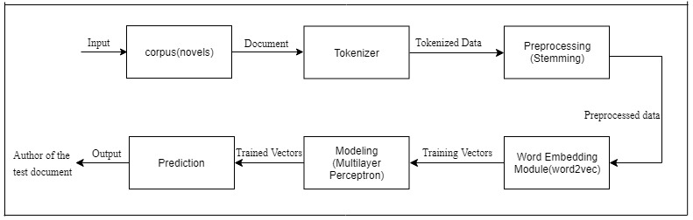
Block Diagram

Slide 15
ALGORITHMS IMPLEMENTED
Vivekanand Education Society’s Institute Of Technology
Department Of Computer Engineering

Slide 16
Algorithms Implemented
Tokenizer : First the corpus data is tokenized into sentences and stored in a list . Then each sentence is tokenized into words. While tokenizing into words, some common stop-words are deleted from the corpus.
Stemming : Stemming usually refers to a crude heuristic process that chops off the ends of words in the hope of achieving this goal correctly most of the time, and often includes the removal of derivational affixes.Porter’s Algorithm can be used. Porter's algorithm consists of 5 phases of word reductions, applied sequentially. Within each phase there are various conventions to select rules, such as selecting the rule from each rule group that applies to the longest suffix.

Slide 17
Algorithms Implemented
Feature Extraction using Word Embedding : Word2vec model is used to extract features from the corpus. Word2Vec takes raw text as input and learns a word by predicting its surrounding context given its surrounding context using gradient descent with randomly initialized vectors. The algorithm reads each word in the corpus and generates a vector by predicting its surrounding context. This preserves the semantic context in the vectors.
Prediction : Corpus comprises of 4 documents each by 5 authors. Out of these documents, three documents per author, are used to train the model. One document per author is kept for testing purpose. Our model is trained using multilayer perceptron with 32 nodes and 32 layers.

Slide 18
SPECIFICATIONS
Vivekanand Education Society’s Institute Of Technology
Department Of Computer Engineering

Slide 19
Hardware Specifications
Software Specifications
DDR4 RAM
4 GB Graphic card
5th generation intel i7 processor or above
Data Processing: Scikit Sklearn Python, Java.
User Interface: Xampp, HTML, CSS, JavaScript, Bootstrap, PHP, Ajax, JQuery.
Data Visualization: Sklearn libraries.

Slide 20
Tools
Visual Studio Code
Jetbrains Pycharm
Sklearn Predictor
Xampp Server

Slide 21
CONSTRAINTS
Vivekanand Education Society’s Institute Of Technology
Department Of Computer Engineering

Slide 22
CONSTRAINTS
Requirement of known documents of undisputed ownership, for the system to analyse and understand the style of the author.
Requirement of relatively large corpus, to achieve high efficacy.
Classifiers built may not achieve 100% accuracy.
Prediction accuracy depends on the data set and the ML algorithm used for training. The data set should be adequate enough.

Slide 23
UI SCREENSHOTS
Vivekanand Education Society’s Institute Of Technology
Department Of Computer Engineering

Slide 24
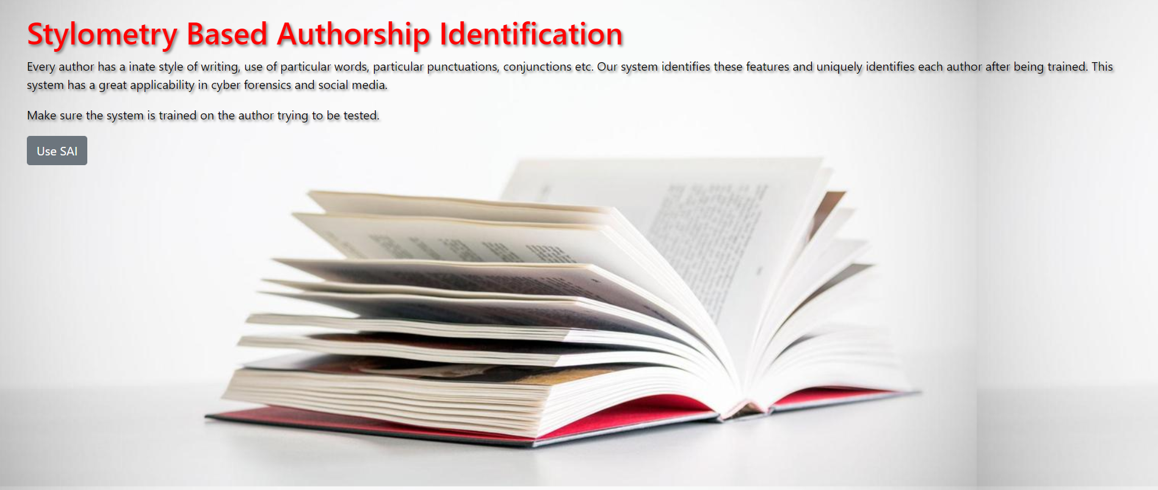
UI SCREENSHOTS

Slide 25
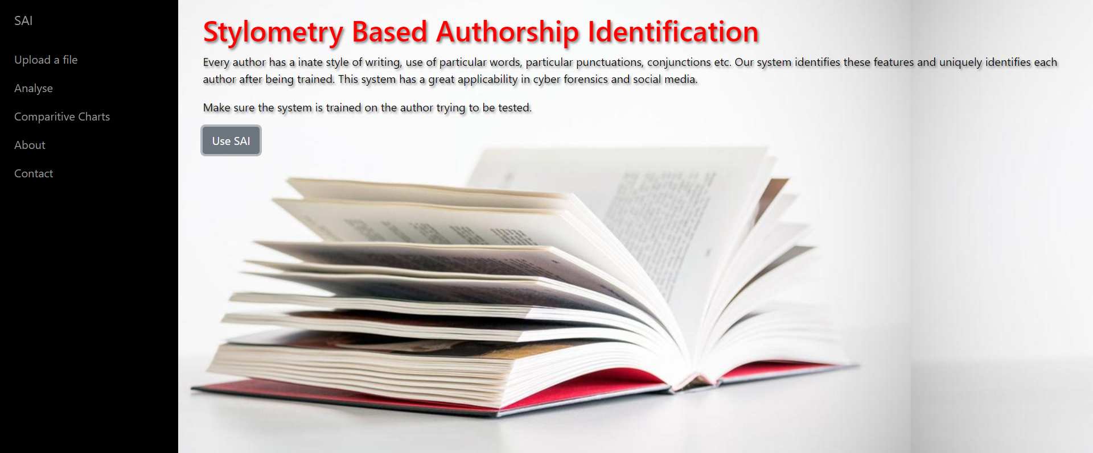
UI SCREENSHOTS

Slide 26

UI SCREENSHOTS

Slide 27
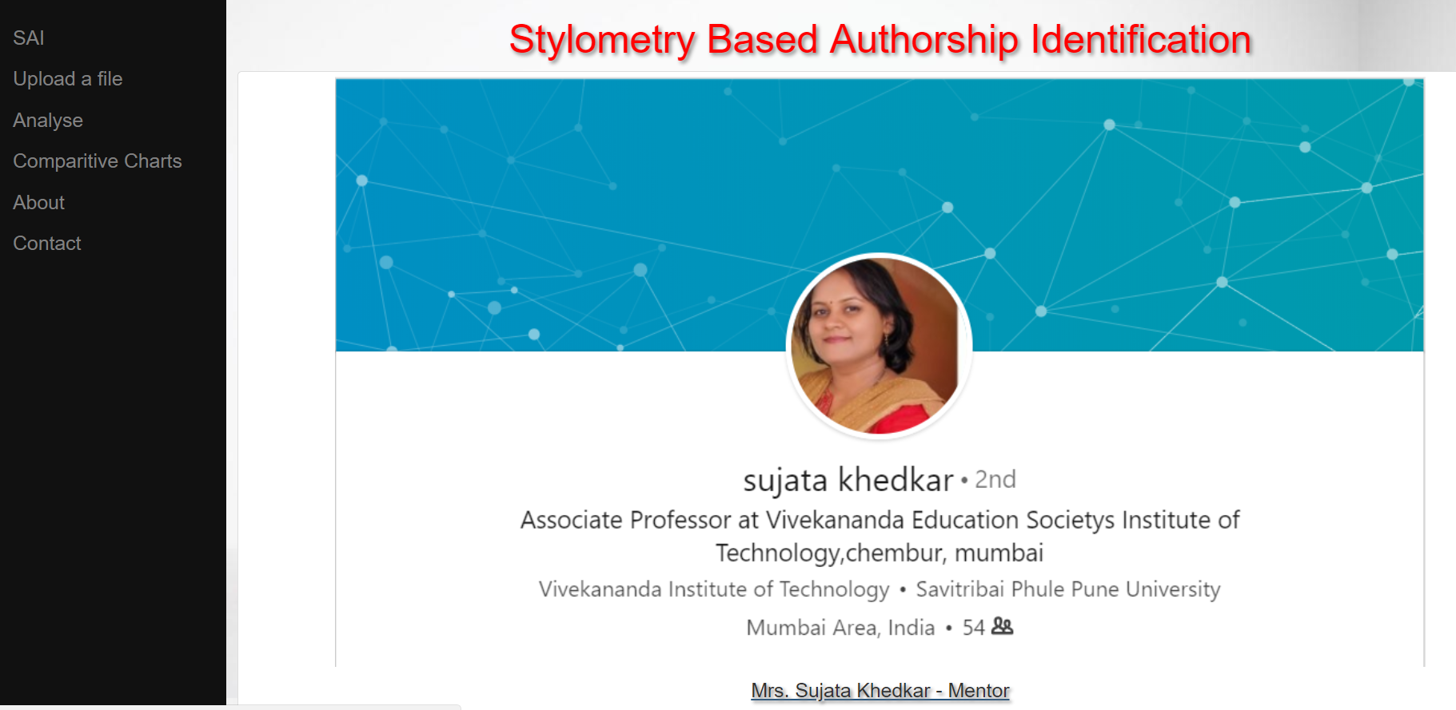
UI SCREENSHOTS

Slide 28
RESULTS OBTAINED
Vivekanand Education Society’s Institute Of Technology
Department Of Computer Engineering

Slide 29
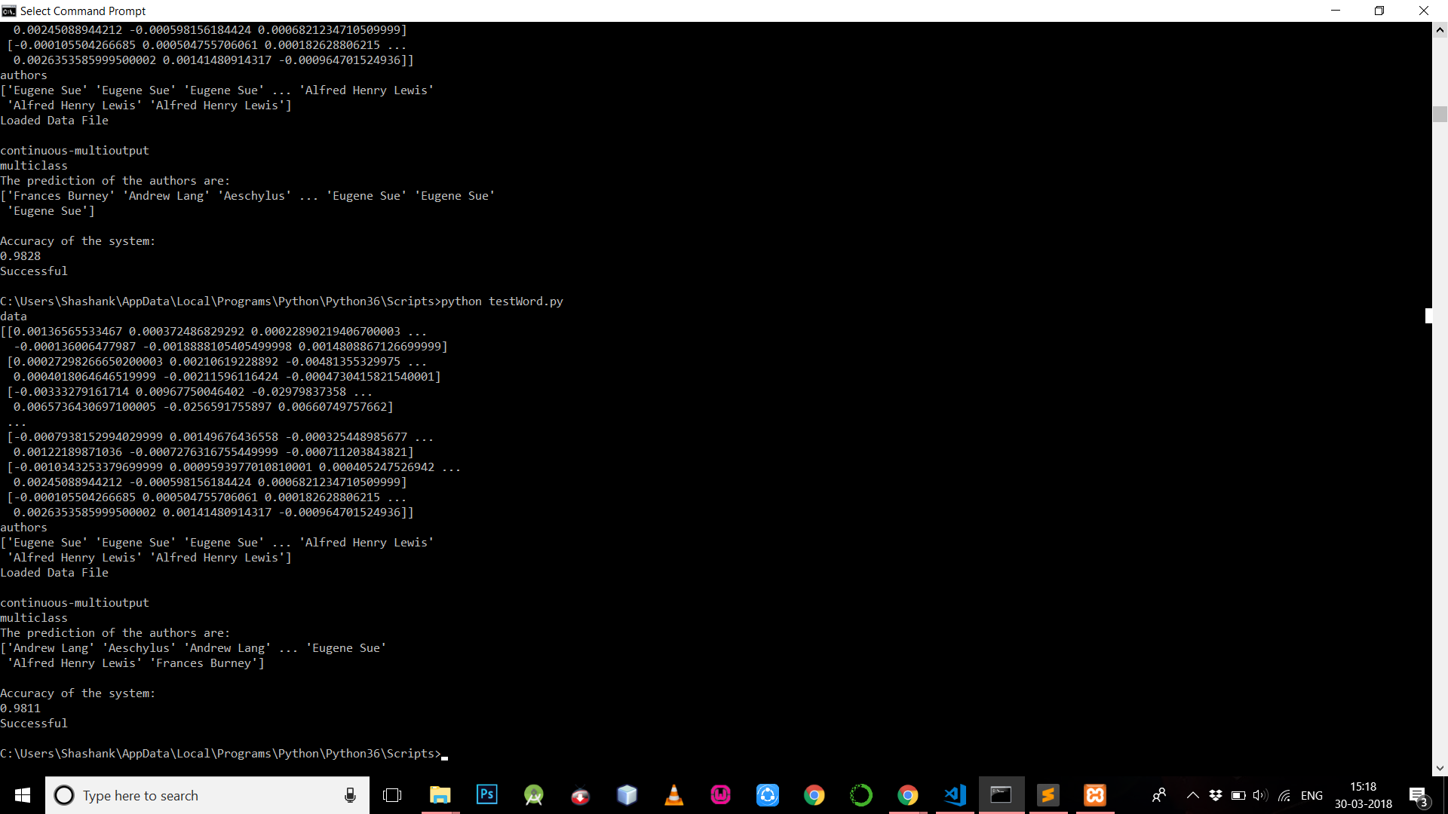
RESULTS OBTAINED
Word 2 Vec using MLP (5 authors)

Slide 30
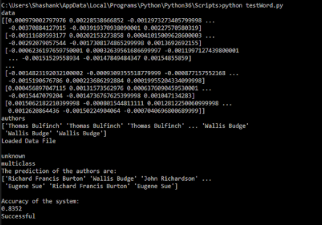
RESULTS OBTAINED
Word 2 Vec using MLP(15 Authors)

Slide 31
GRAPHS GENERATED
Vivekanand Education Society’s Institute Of Technology
Department Of Computer Engineering

Slide 32
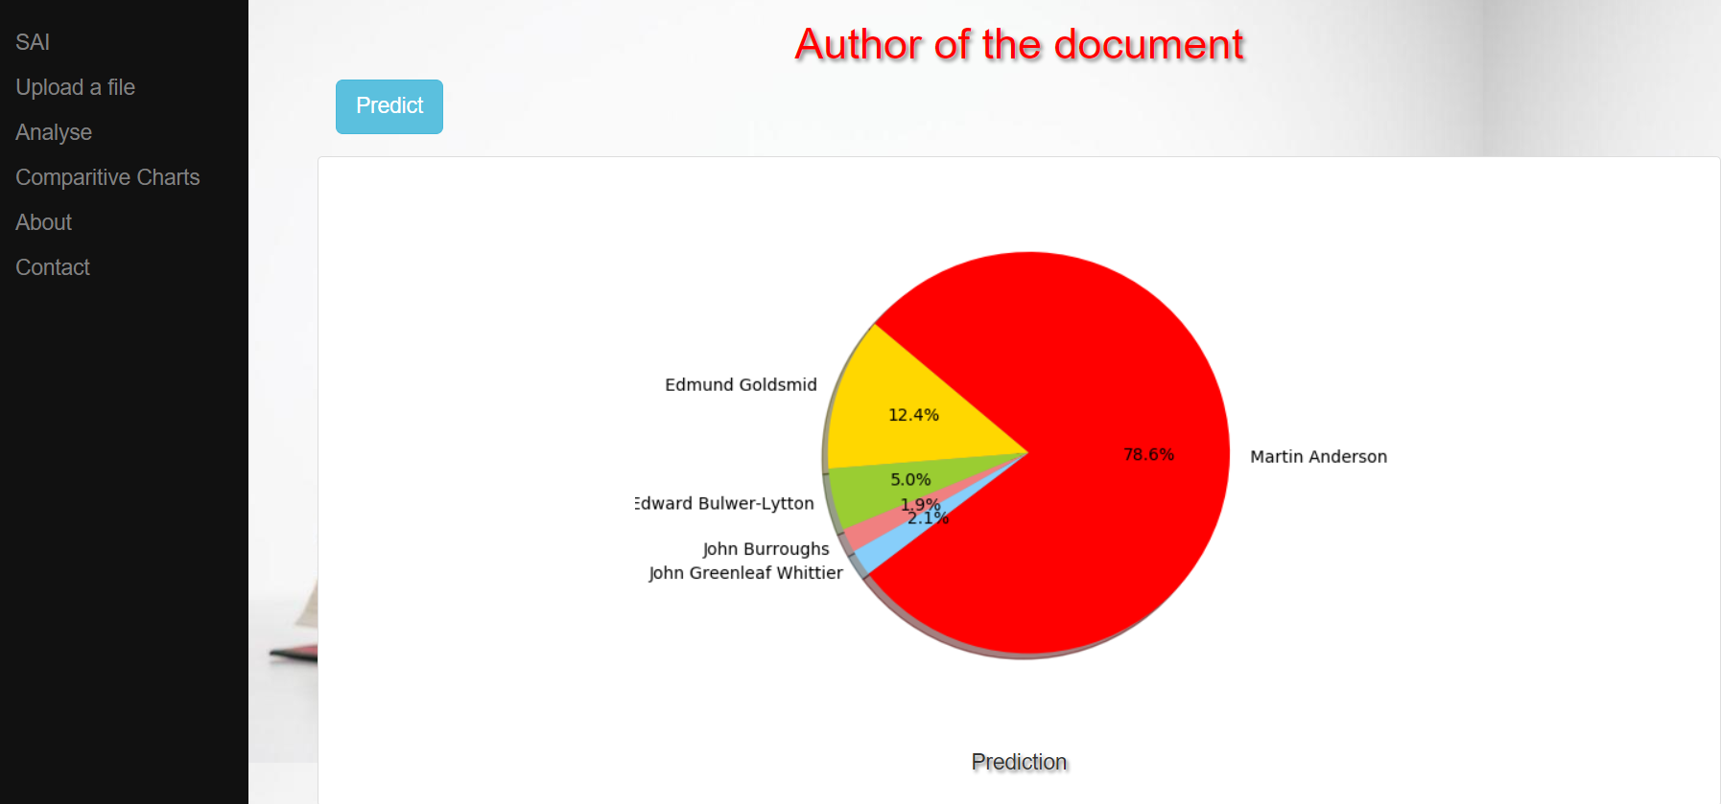
GRAPHS GENERATED

Slide 33
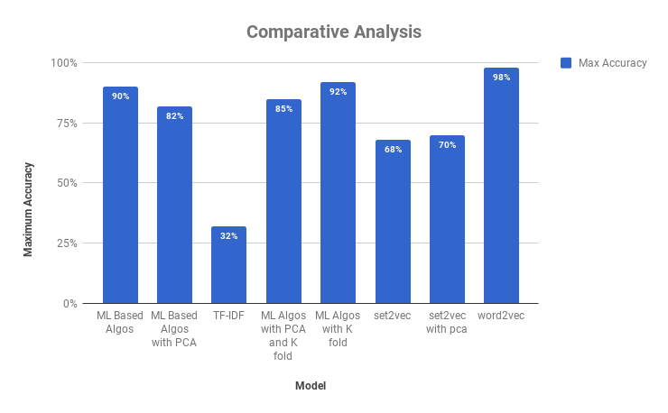
GRAPHS GENERATED

Slide 34
COMPARISON WITH THE EXISTING SYSTEM
Vivekanand Education Society’s Institute Of Technology
Department Of Computer Engineering

Slide 35
Comparison with Existing System
Existing System | SAI
In traditional studies on authorship attribution, the focus is on small sets of authors. Generally the set contains less than 50 authors, in some cases it is as low as 10 authors. | In our project we have considered 438 authors to solve author attribution problem. This is a very large corpus compared to the ones used by the existing systems.
For adding new entries to the dataset the whole process of preprocessing, feature extraction and training needs to be done again and again which takes up more memory space and increases the time and computational complexities. | For adding new entries to the dataset whole process of preprocessing and training need not be done again and again which reduces the memory requirements and has relatively less time and computational complexities.
The accuracy of the existing systems drop sharply when the corpus size is increased to a large dataset. The highest accuracy achieved in any existing system never exceeded 85% despite considering only a few authors. | The accuracy of our system does not drop much when the number of authors increases. The highest accuracy achieved by our model is 98.11% when 5 authors were considered.
The existing systems invests a lot of time and processing power in preprocessing steps like stemming and principal component analysis which might decrease the space to be occupied by the corpus but results in the loss of vital information regarding the data. | In our system instead of losing vital information due to Principal Component Analysis and Stemming, we perform data cleaning and use bag of words in preprocessing. This enables us to have a preprocessed corpus while no vital information is lost.

Slide 36
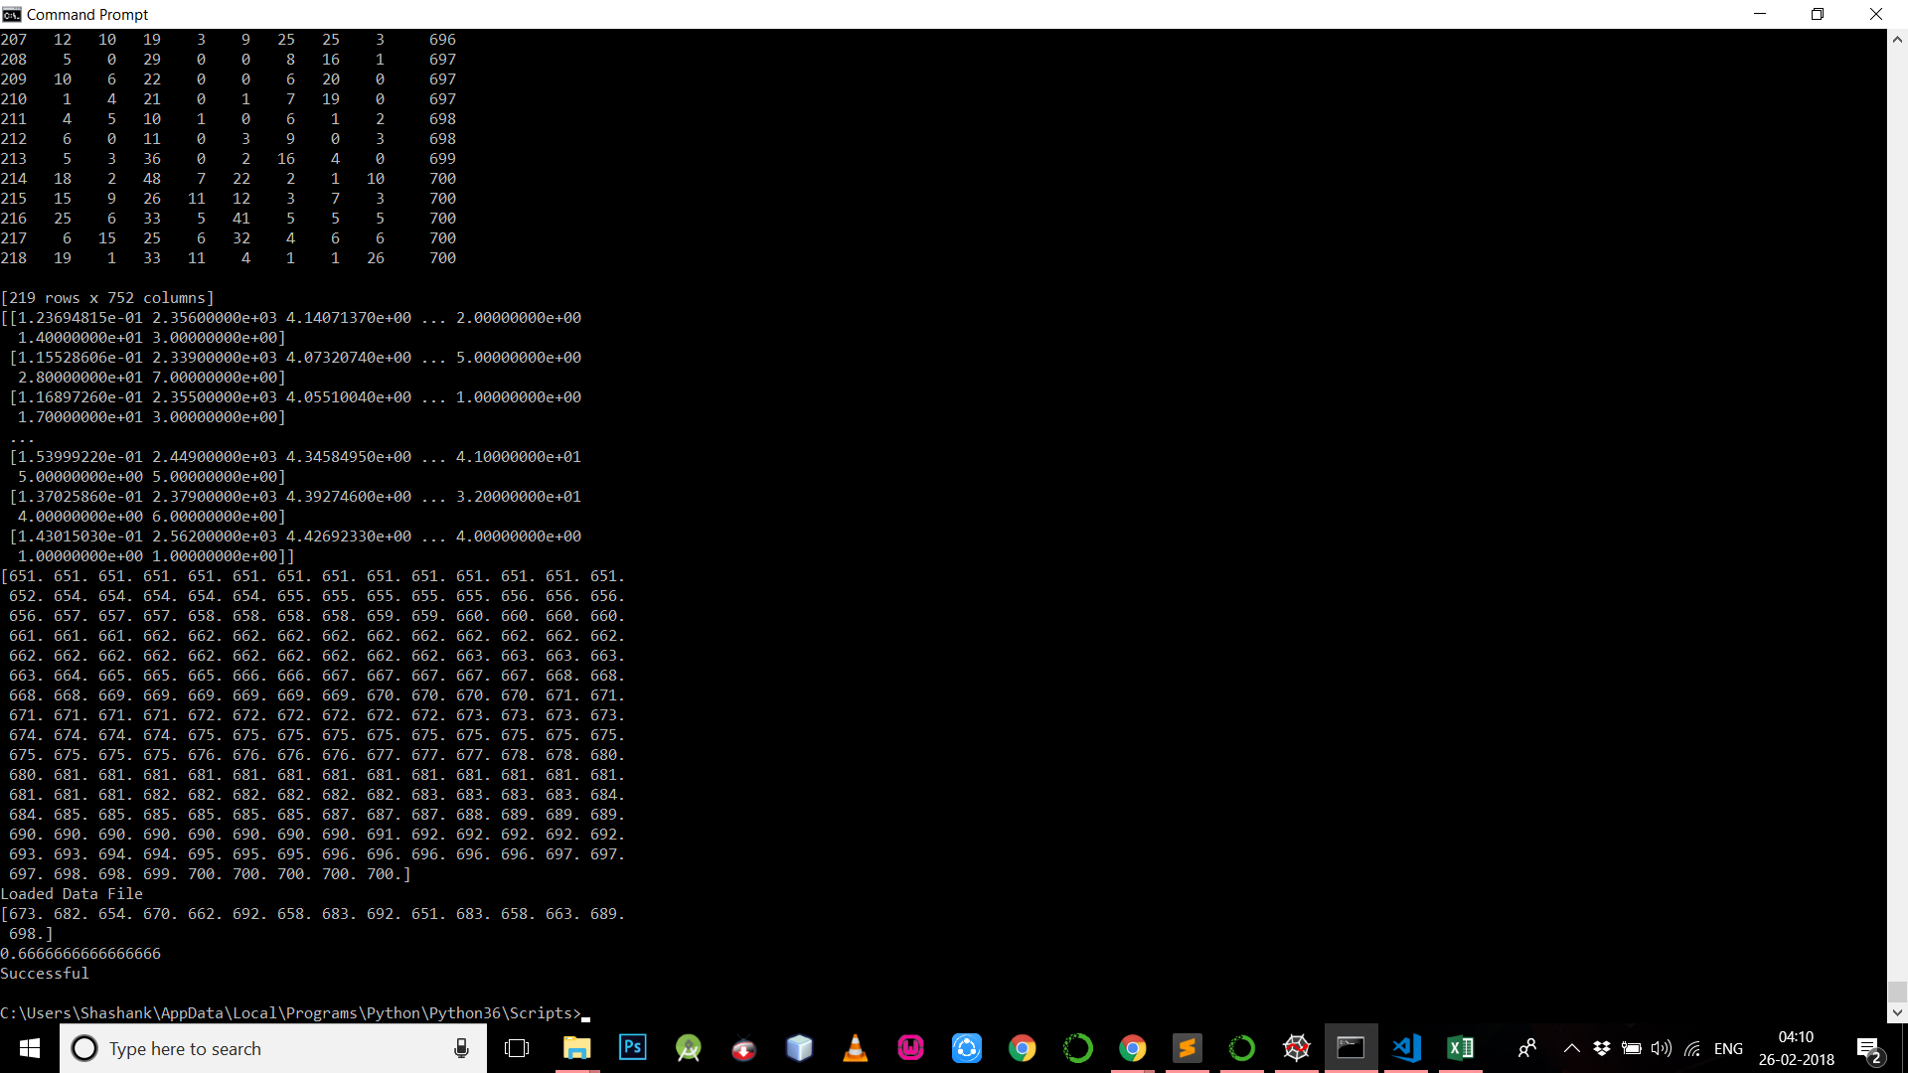
Comparison with the Existing System
K Nearest Neighbors Algorithm with 4 neighbors.

Slide 37

Comparison with the Existing System
K Nearest Neighbors Algorithm with 6 neighbors.

Slide 38
COMPARATIVE ANALYSIS
Vivekanand Education Society’s Institute Of Technology
Department Of Computer Engineering

Slide 39
COMPARATIVE ANALYSIS
Machine Learning Based Algorithms using Term Frequency
Algorithm | Low Frequency | Mid Frequency | High Frequency
SVM (C=1.5, Degree=3, Kernel=poly) | 57-62% | 65-70% | 85-90%
Neural Network - MLP (hidden_layer_sizes=(32,32) , alpha = 0.001) | 60-63% | 60-65% | 60-70%
Decision Tree (CART) | 37-40% | 37-42% | 43-47%
Machine Learning Based Algorithms with PCA using Term Frequency (n = Number of Components)
Algorithm | Low Frequency(n=15000-20000) | Mid Frequency(n=700) | High Frequency(n=1000 - 2500)
SVM (C=1.5, Degree=3, Kernel=poly) | 60-65% | 64-67% | 77-82%
Neural Network - MLP (hidden_layer_sizes=(32,32) , alpha = 0.001) | 53-56% | 57-59% | 54-58%
Decision Tree (CART) | 30-32% | 32-34% | 34-37%

Slide 40
COMPARATIVE ANALYSIS
Machine Learning Based Algorithms with PCA and K-fold validation (n=Number of Components and K = 10)
Algorithm | Low Frequency(n=15000-20000) | Mid Frequency(n=700) | High Frequency(n=1000 - 2500)
SVM (C=1.5, Degree=3, Kernel=poly) | 60-66% | 65-68% | 84-85%
Neural Network - MLP(hidden_layer_sizes=(32,32) ,alpha = 0.001) | 56-58% | 70-73% | 68-70%
Decision Tree (CART) | 31-34% | 35-37% | 40-43%
Machine Learning Based Algorithms with K-fold validation (K=10)
Algorithm | Low Frequency | Mid Frequency | High Frequency
SVM (C=1.5, Degree=3, Kernel=poly) | 60-62% | 75-77% | 90-92%
Neural Network - MLP(hidden_layer_sizes=(32,32) ,alpha = 0.001) | 66-68% | 75-77% | 67-75%
Decision Tree (CART) | 41-45% | 44-55% | 47-52%

Slide 41
COMPARATIVE ANALYSIS
sentence2Vec with PCA
Algorithm | Accuracy
SVM (C=1.5, Degree=3, Kernel=poly) | 41%(5 authors) , 19%(15 authors)
Neural Network - MLP (hidden_layer_sizes=(32,32) , alpha = 0.001) | 70%(5 authors) , 67%(15 authors)
Decision Tree (CART) | 54%(5 authors) , 43%(15 authors)
word2Vec (vector size = 300)
Algorithm | Accuracy
SVM (C=1.5, Degree=3, Kernel=poly) | 65%(5 authors),
Neural Network - MLP(hidden_layer_sizes=(32,32) , alpha = 0.001) | 98.11% (5 authors), 84%(15 authors)
Decision Tree (CART) | 97.45%(5 authors), 45%(15 authors)

Slide 42
LIMITATIONS
Vivekanand Education Society’s Institute Of Technology
Department Of Computer Engineering

Slide 43
LIMITATIONS
Prediction accuracy depends on the data set considered in training the system and the time, space and computational complexities heavily depends on the relationship and mutual importance of every word with respect to the other words in a single document and documents written by other authors.
For fast computation and processing the system should have high computational power which includes a fast RAM (minimum of 8GB), a powerful processor and a high end graphic card.

Slide 44
FUTURE SCOPE
Vivekanand Education Society’s Institute Of Technology
Department Of Computer Engineering

Slide 45
FUTURE SCOPE
Our system requires many words from each author to train itself to their writing style.
The future scope for our project is improving it to predict authors successfully even on a small dataset from each other, like twitter tweets or short online messages and posts.
This will enable cyber police in forensics when the case pertains to authenticity or accurately determining the true author of a message or post present online by just studying the writing styles prevalent on the online and social networking portals and those stored in the present models saved after forensics performed on previous cases.
Another application can be identification of multiple users as the author of a single document which does not take place in the current model.

Slide 46
CONCLUSIONS
Vivekanand Education Society’s Institute Of Technology
Department Of Computer Engineering

Slide 47
Conclusion
In this study, we investigated an alternative technique to automatically classify various authors by training our system to predict authors.
Various feature extractions techniques as mentioned in the slides above are used.
The project proposed the features to be extracted from the document which hopefully would assist in increasing accuracy and reducing a few redundant dimensions.
This project can identify the large number of authors successfully.

Slide 48
REFERENCES
Vivekanand Education Society’s Institute Of Technology
Department Of Computer Engineering

Slide 49
REFERENCES
[1] Krause, Markus, "Stylometry-based Fraud and Plagiarism Detection for Learning at Scale", 2015 5th KSS Workshop, Karlsruhe, Germany
[2] Ángel Hernández-Castañeda, Hiram Calvo , "Author Verification Using a Semantic Space Model.", Computación y Sistemas, Vol. 21, No. 2, 2017, pp. 167–179
[3] J. Hurtado, N. Taweewitchakreeya and X. Zhu, "Who wrote this paper? Learning for authorship de-identification using stylometric features," Proceedings of the 2014 IEEE 15th International Conference on Information Reuse and Integration (IEEE IRI 2014), Redwood City, CA, 2014, pp. 859-862.
[4] P. Das, R. Tasmim and S. Ismail, "An experimental study of stylometry in Bangla literature," 2015 2nd International Conference on Electrical Information and Communication Technologies (EICT), Khulna, 2015, pp. 575-580.
[5] He, Congzhou & Rasheed, Khaled. (2004). "Using Machine Learning Techniques for Stylometry", Proceedings of the International Conference on Artificial Intelligence, IC-AI '04, Volume 2 & Proceedings of the International Conference on Machine Learning; Models, Technologies & Applications,2004
[6] Marcelo Luiz Brocardo, Issa Traore, Sherif Saad, Isaac Woungang , "Authorship Verification for Short Messages using Stylometry", 2013 International Conference on Computer, Information and Telecommunication Systems, pp. 1-6
[7] Ramnial H., Panchoo S., Pudaruth S, "Authorship Attribution Using Stylometry and Machine Learning Techniques", 2016 Intelligent Systems Technologies and Applications. Advances in Intelligent Systems and Computing, vol 384. Springer, Cham
[8] Maciej Eder, Jan Rybicki and Mike Kestemont , "Stylometry with R: A Package for Computational Text Analysis",The R Journal Vol. 8/1, Aug. 2016

Slide 50
REFERENCES
[9] Lakshmi, Pushpendra Kumar Pateriya, "A Study on Author Identification through Stylometry ",Lakshmi et al , International Journal of Computer Science & Communication Networks,Vol 2(6), pp. 653-657
[10] Ganapathi N V Raju, Ch. Sadhvi, P Tejaswini and Y Mounica, "Style based Authorship Attribution on English Editorial Documents", International Journal of Computer Applications 159(4), pp. 5-8, February 2017.
[11] A. Rocha et al., "Authorship Attribution for Social Media Forensics," in IEEE Transactions on Information Forensics and Security, vol. 12, no. 1, pp. 5-33, Jan. 2017.
[12] Helena G ́omez-Adorno, Posadas-Dur ́an, Juan-Pablo, Grigori Sidorov, David Pinto," Document Embeddings Learned on Various Types of n-grams for Cross-Topic Authorship Attribution" , in Computing 2018, pp. 1-16.
[13] Đlker Nadi Bozkurt, Özgür Bağlıoğlu, Erkan Uyar, "Authorship Attribution Performance of various features and classification methods", in Proceedings Bozkurt Authorship AP, 2017
[14] Crawford, Michael, et al. "Survey of review spam detection using machine learning techniques." Journal of Big Data 2.1 (2015): 23.
[15] Willett, Peter. "The Porter stemming algorithm: then and now." Program 40.3 (2006): 219-223.
[16] Jolliffe, Ian T. "Principal Component Analysis and Factor Analysis." Principal component analysis. Springer New York, 1986. 115.

Slide 51
THANK YOU
Vivekanand Education Society’s Institute Of Technology
Department Of Computer Engineering

